Slide 1
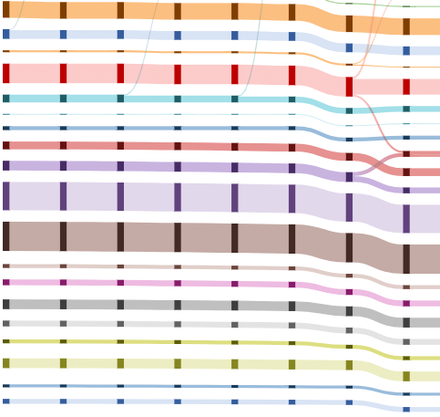
Job Stream
Weekly report

Slide 2
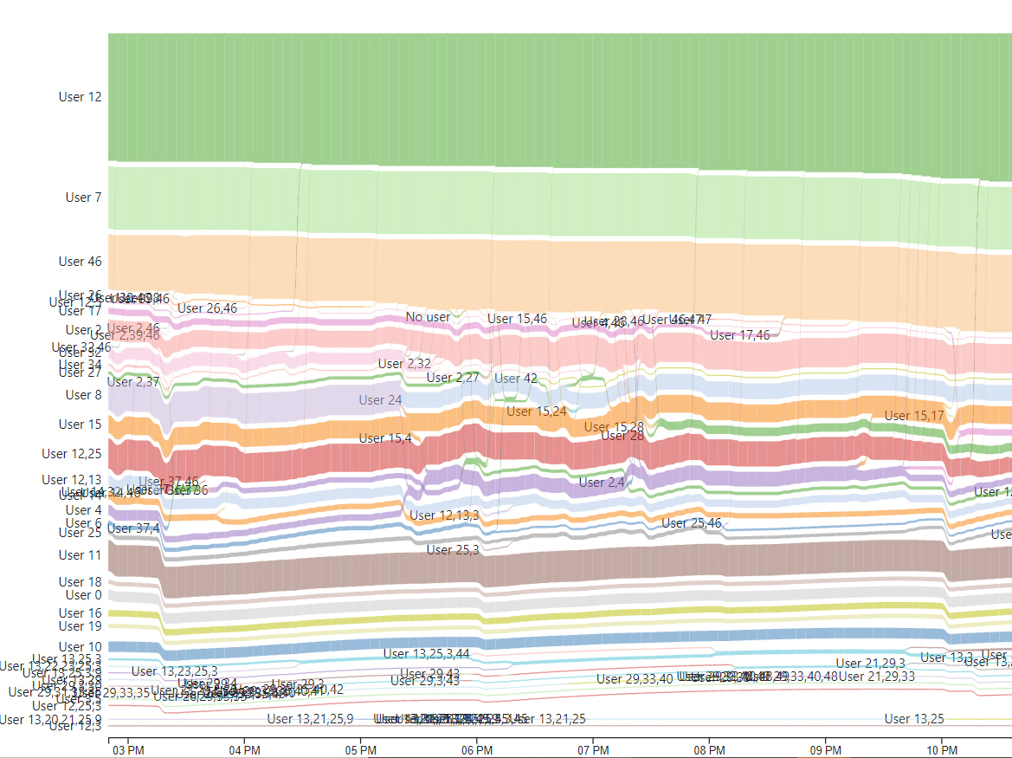
Job Stream
User flow
Color by user
The Band height is #nodes/#CPU cores each user(s) utilizing

Slide 3
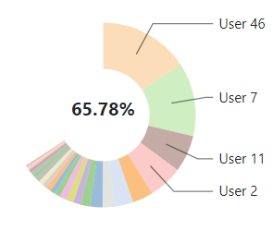
Pie chart
#CPU Cores each user utilizing
Color by user

Slide 4
Job Stream
Historical data
https://idatavisualizationlab.github.io/HPCC/sankeyViewer/index.html

Slide 5
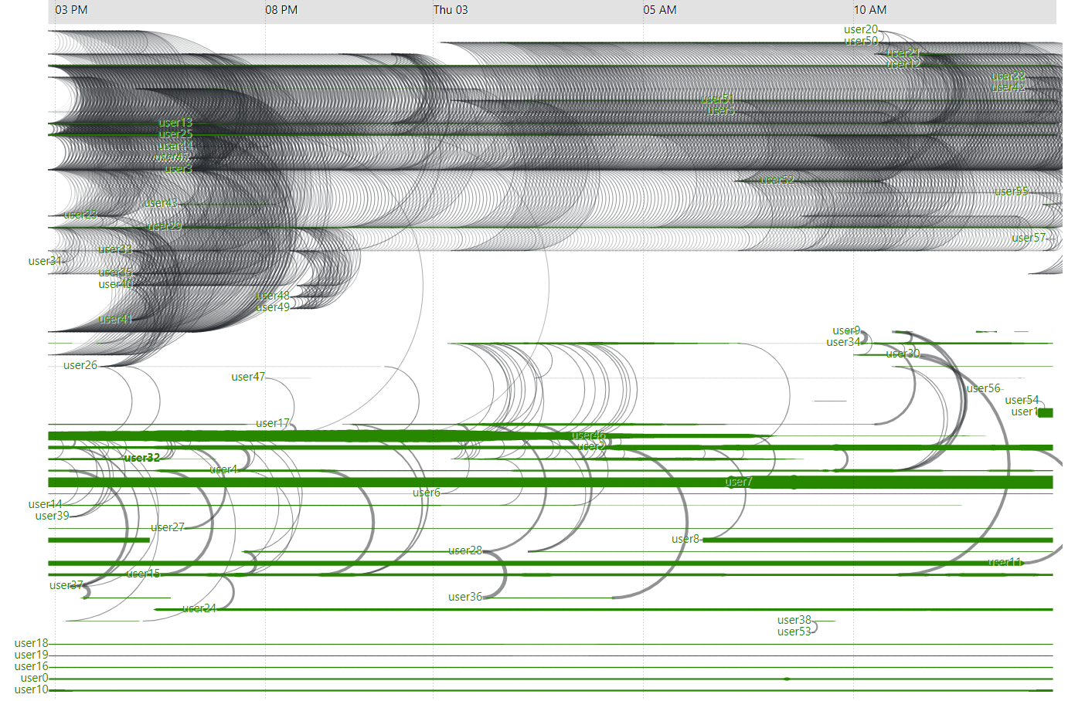
TimeArc

Slide 6
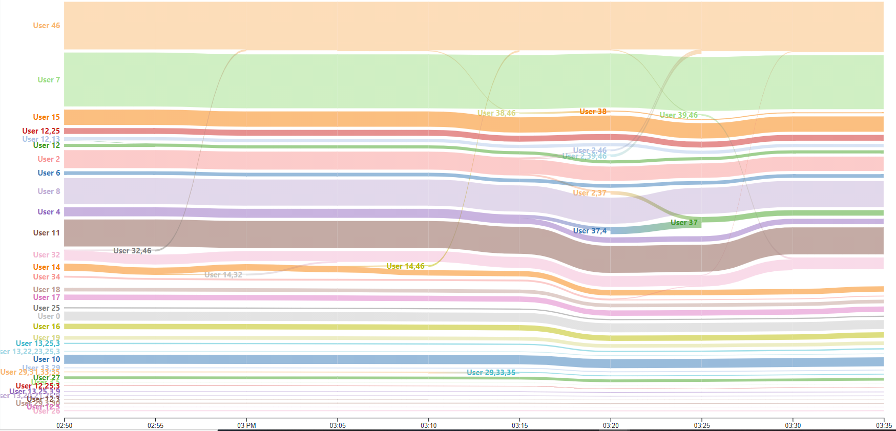
Sankey

Slide 7
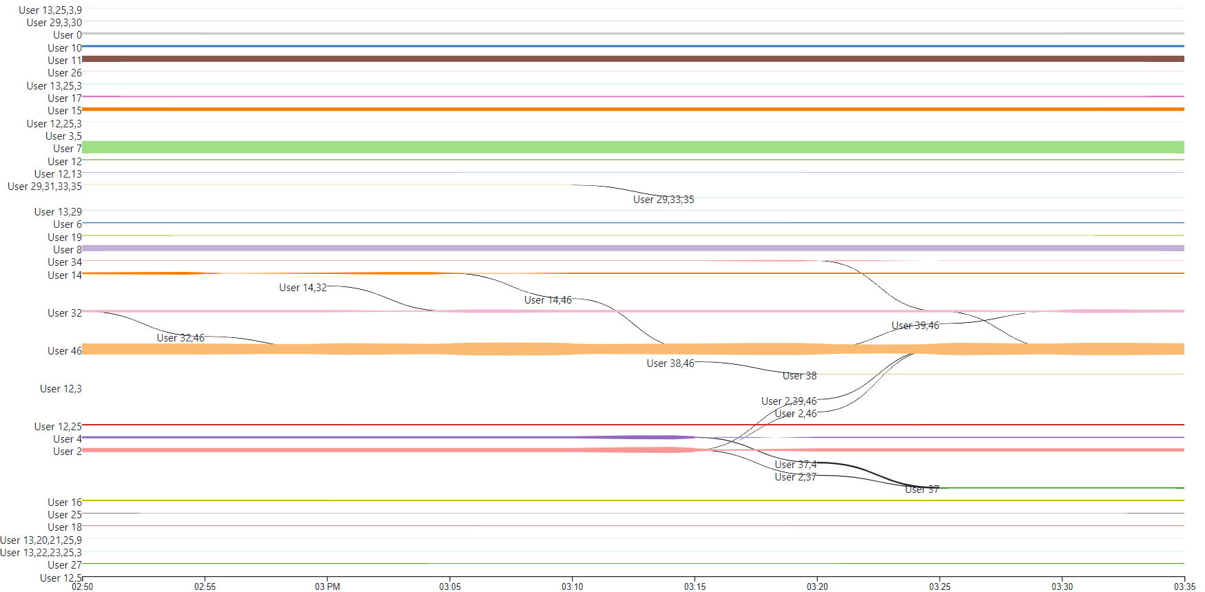
TimeArc

Slide 8
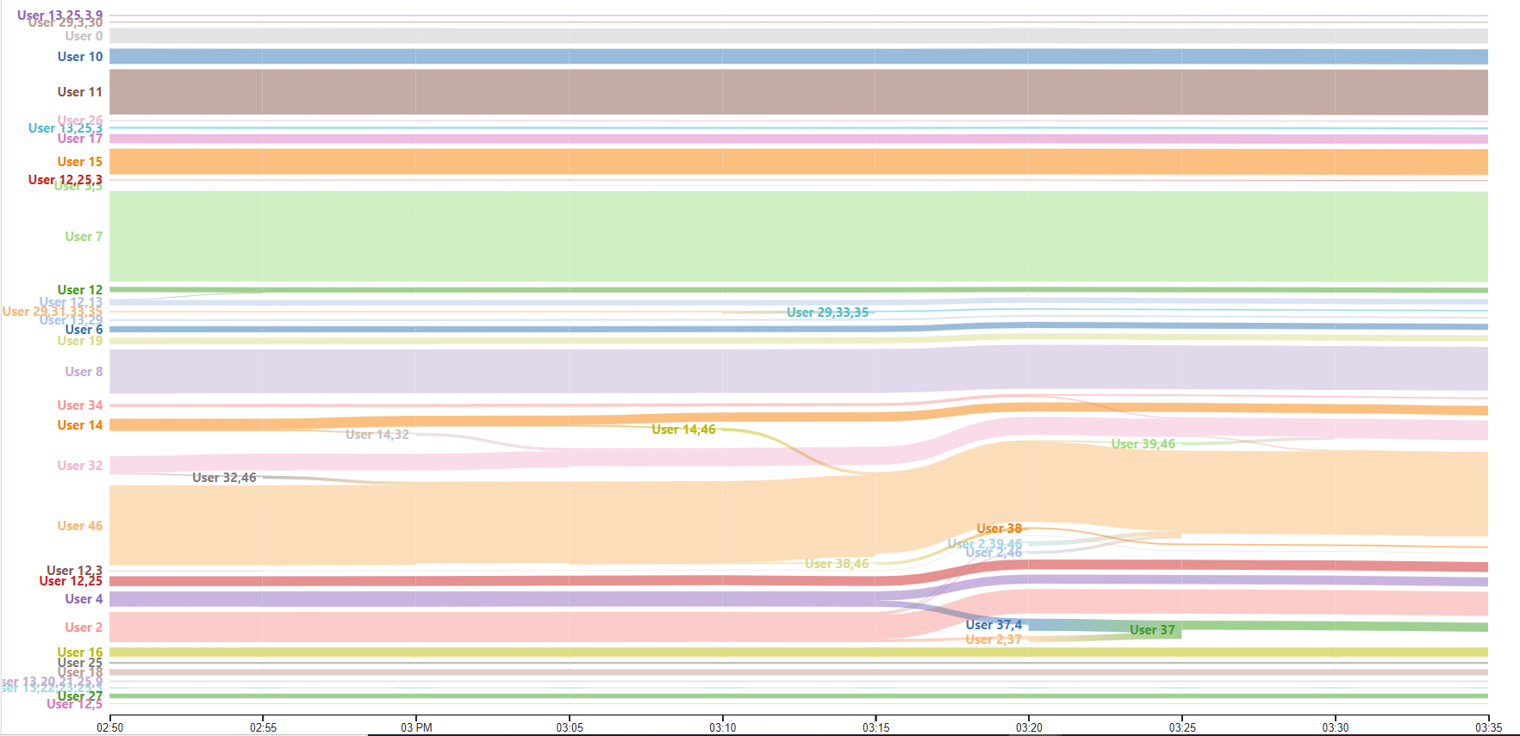
Sankey + TimeArc

Slide 9
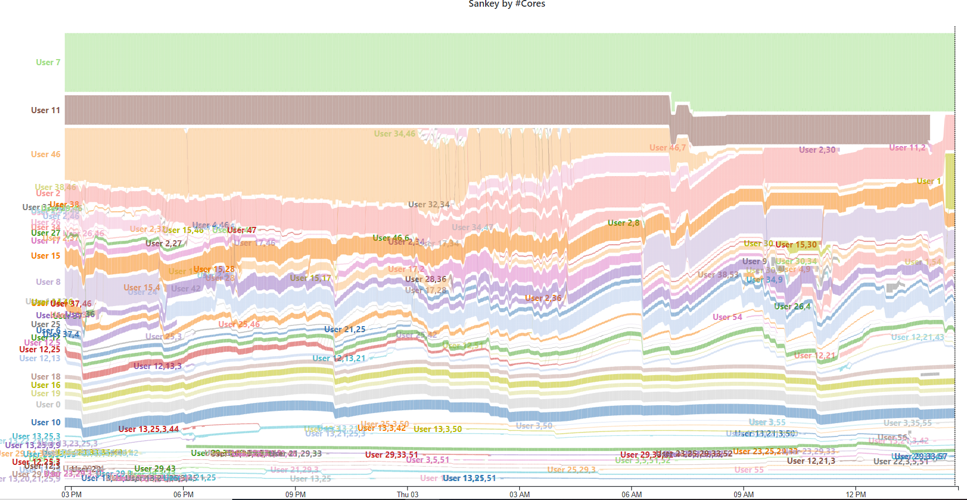
Sankey 1 day data

Slide 10
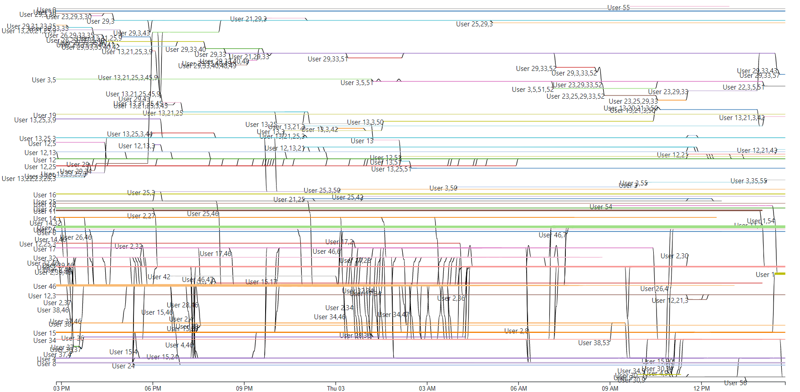
TimeArc

Slide 11
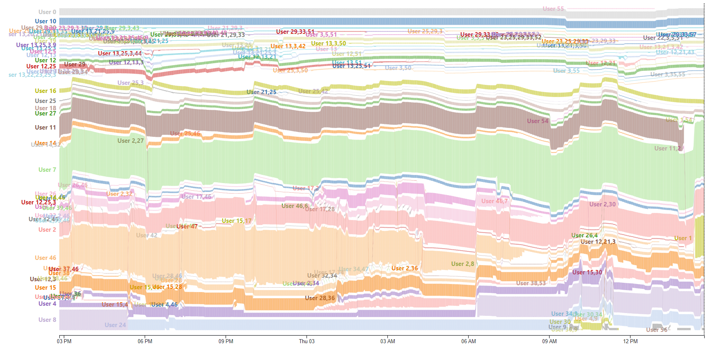
Job Stream

Slide 12
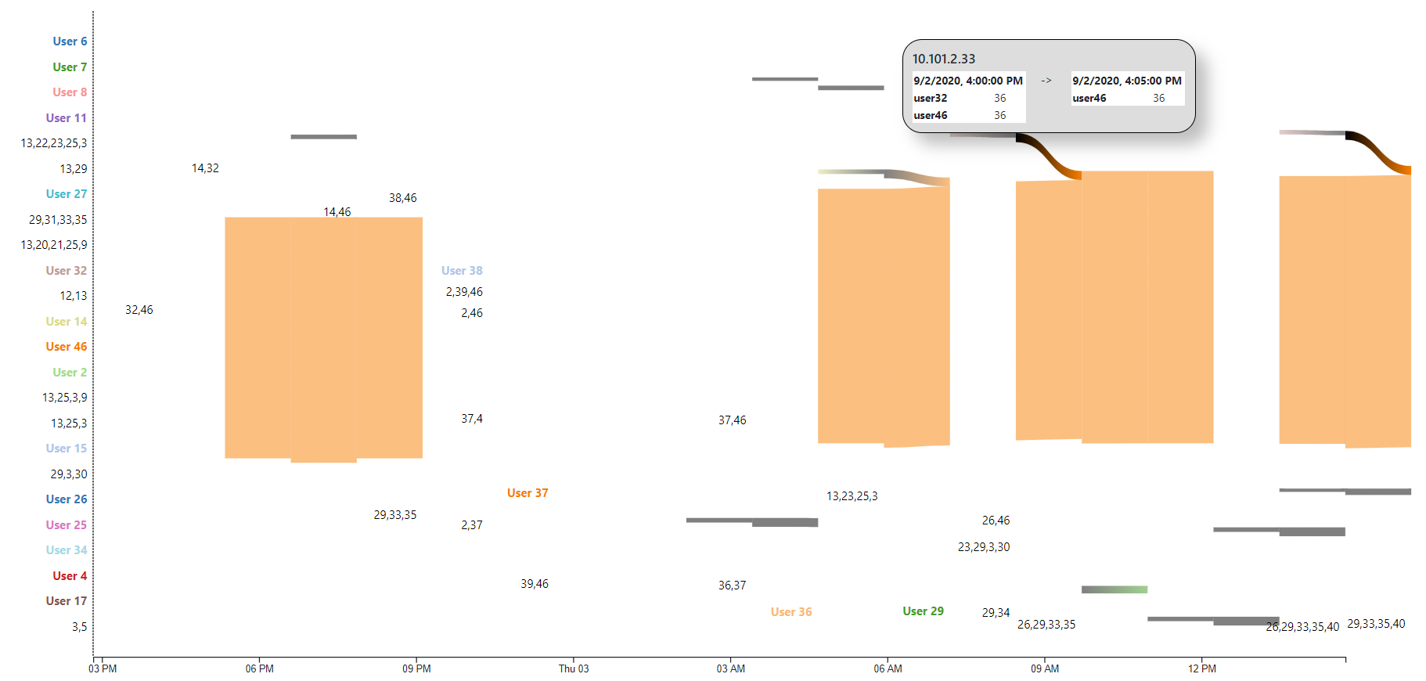
Job Stream
User use more than 36 cores per node

Slide 13
Job Stream
User use more than 36 cores per node
3 jobs running at the same time?
a) API results
15:15
15:20
15:25
15:30
1945343
1952510
1951634.7
15:21
15:22
Running job
at 10.101.1.21
by API
[1945343]
[ 1945343,
1952510,
1951634.7 ]
[1951634.7]
[1951634.7]
b) Surmise
15:15
15:20
15:25
15:30
1945343
1952510
1951634.7
15:21
15:22

Slide 14
Job Stream
User use more than 36 cores per node
b) Surmise 1
Users using virtual cores. Do we have the limit for #virtual cores?
c) Surmise 2
15:15
15:20
15:25
15:30
1945343
1952510
1951634.7
15:21
15:22
d) Surmise 3
15:15
15:20
15:25
15:30
1945343
1952510
1951634.7
Clean up
15:21
15:22

